Slide 1
SCHOOL OF COMPUTING
DEPARTMENT OF COMPUTER SCIENCE & ENGINEERING
18CSC305J Artificial Intelligence
6th SEMESTER MINI PROJECT
FACE MASK DETECTION
PRESENTED BY:
IKLASH KHAN - RA2011003011391
SIDDHARTH SINGH - RA2011003011391
VICKY KUMAR - RA2011003011391
SUPERVISED BY:
Dr.K.Deeba
Associate Professor

Slide 2
AGENDA
Abstract
Introduction
Problem Definition
Dataset
TechStack/Frameworks used
Libraries Required
Architecture and Design
Codes
Outputs
Github
Working
Future Works
References

Slide 3
Abstract
Face mask recognition has been growing rapidly after the spread of corona in the last couple of years. It's been used in the areas of Law Enforcement, Security purposes and other commercials to prevent spreading of corona. Therefore a novel approach to perform face new line detection and face mask recognition was proposed.
This proposed system is to classify face mask detection using COVID-19 precaution both in images and videos using convolution neural network. Extensive experimentation on the datasets and the performance evaluation of the proposed methods are exhibited.

Slide 4
Further, we made a successful attempt to preserve inter and intra class variations of face mask detection using symbolic approach. We studied the different classifiers like Support Vector Machine and a Symbolic Classifier. The project is developed as a prototype to monitor temperature measurement and to detect mask for the people.
We proposed continuous monitoring of the people's conditions and storing the people's data in the server using the Deep learning concept. To investigate the performance of the proposed method,extensive experimentation is conducted on 4000 various Images. We conducted experimentation under varying training and testing percentages and from the results, we could observe that the results obtained for the symbolic approach are better than the conventional approach.

Slide 5
Introduction
The spread of COVID-19 is increasingly worrying for everyone in the world. This virus can be affected from human to human through the droplets and airborne. According to the instruction from WHO, to reduce the spread of COVID-19, every people need to wear face mask, do social distancing, evade the crowd area and also always maintain the immune system. Therefore, to protect each other, every person should wear the face mask properly when they are in outdoor. However, most of selfish people won’t wear the face mask properly with so many reasons.
To overcome this situation, a robust face mask detection needs to be developed. In order to detect a face mask, the object detection algorithm can be implemented. So we have developed a Face-Mask-Detection model doesn't use any morphed masked images dataset and the model is accurate. Owing to the use of MobileNetV2 architecture, it is computationally efficient, thus making it easier to deploy the model to embedded systems (Raspberry Pi, Google Coral, etc.).

Slide 6
PROBLEM DEFINITION
To develop an AI model that can detect Face masks to differentiate between those who wear a mask and not wear a mask.

Slide 7
Dataset
This dataset consists of 4095 images belonging to two classes:
with_mask: 2165 images
without_mask: 1930 images
The images used were real images of faces wearing masks. The images were collected from the following sources:
Bing Search API
Kaggle datasets
RMFD dataset

Slide 8
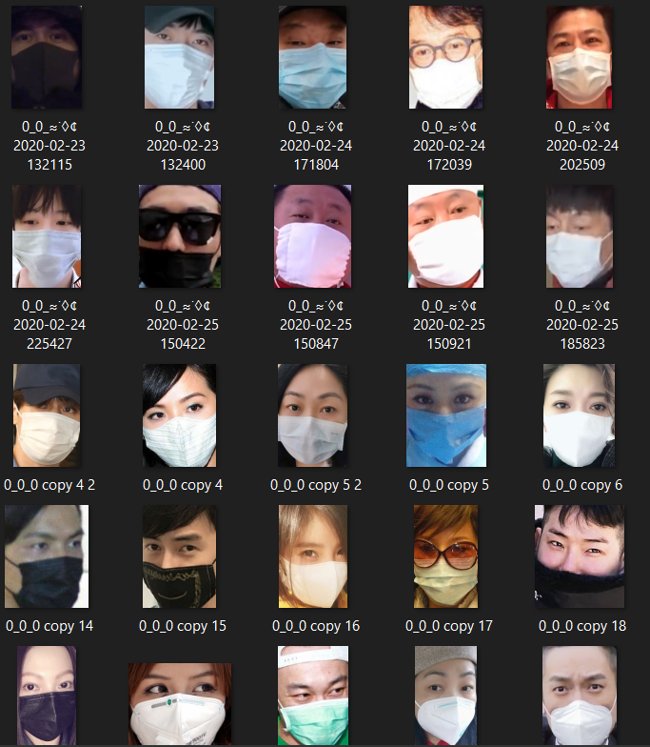
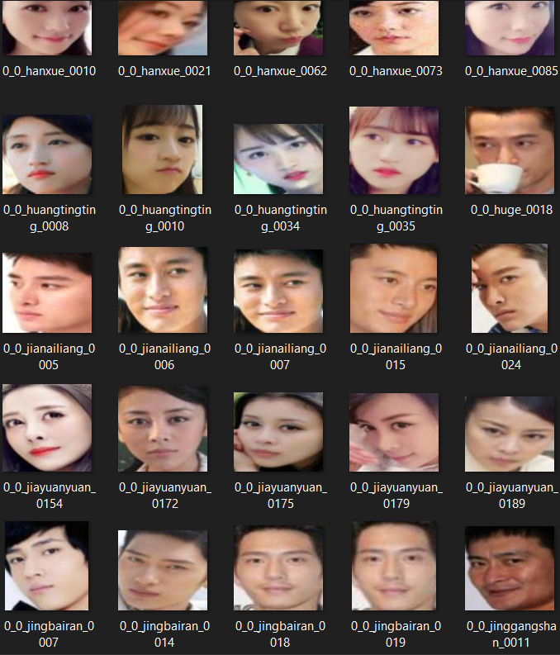
With Mask
Without Mask

Slide 9
TechStack/Framework used
OpenCV
Caffe-based face detector
Keras
TensorFlow
MobileNetV2

Slide 10
Libraries Required
tensorflow>=2.5.0*
keras==2.4.3
imutils==0.5.4
numpy==1.19.5
opencv-python>=4.2.0.32
matplotlib==3.4.1
argparse==1.4.0
scipy==1.6.2
scikit-learn==0.24.1
pillow>=8.3.2
streamlit==0.79.0
onnx==1.10.1
tf2onnx==1.9.3

Slide 11
Architecture and Design

Slide 12
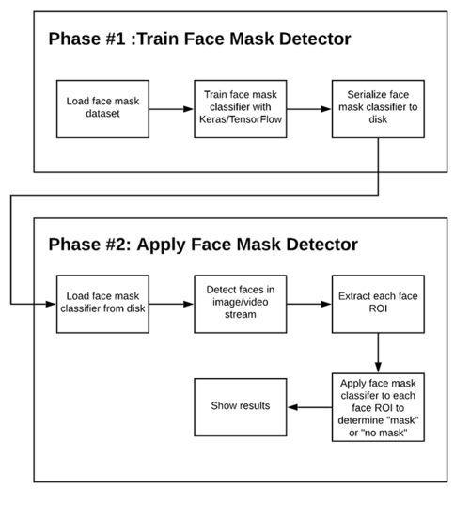
Phases and individual steps for building a COVID-19 face mask detector with computer vision and deep learning using Python, OpenCV, and TensorFlow/Keras.

Slide 13
In order to train a custom face mask detector, we need to break our project into two distinct phases, each with its own respective sub-steps:
Training: Here we’ll focus on loading our face mask detection dataset from disk, training a model (using Keras/TensorFlow) on this dataset, and then serializing the face mask detector to disk.
Deployment: Once the face mask detector is trained, we can then move on to loading the mask detector, performing face detection, and then classifying each face as with_mask or without_mask

Slide 14
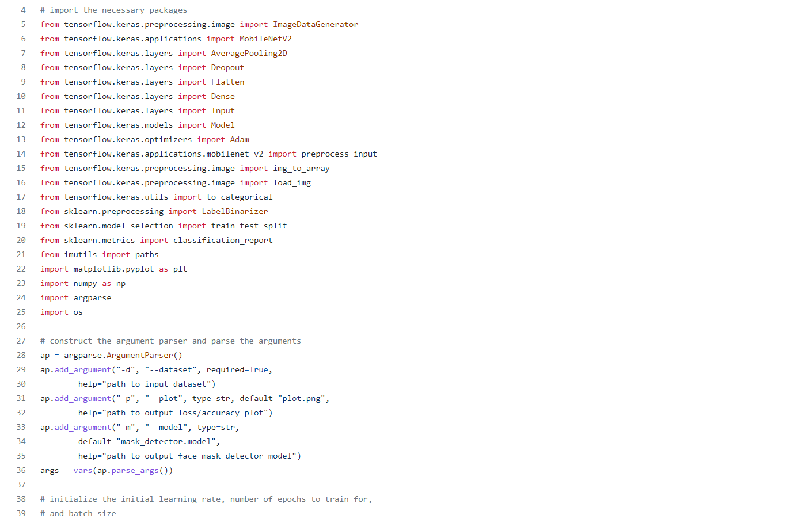
Model Training code

Slide 15
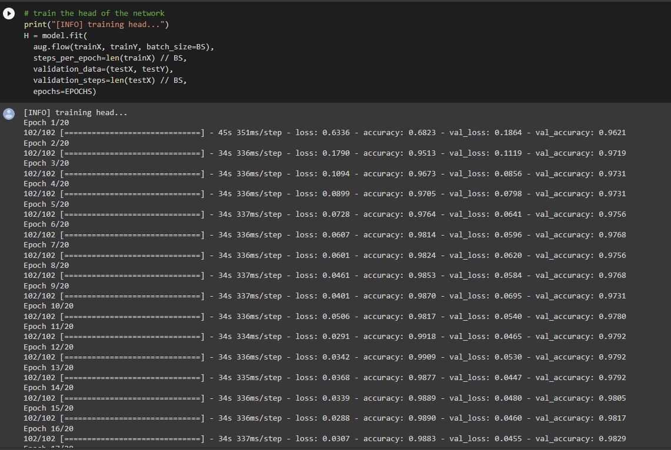
Epochs for better accuracy

Slide 16
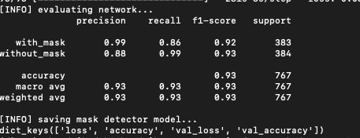
Result of the Training
Our model gave 98% accuracy for Face Mask Detection after training via tensorflow-gpu==2.5.0

Slide 17
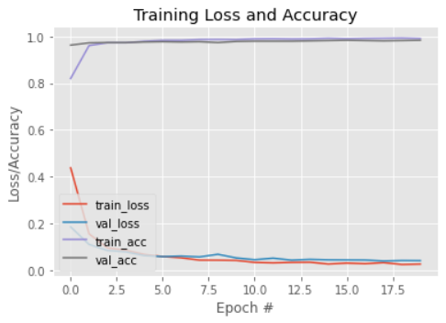
Accuracy/Loss Training curve plot

Slide 18
Detect mask from image code

Slide 19
Detect mask from video stream code

Slide 20
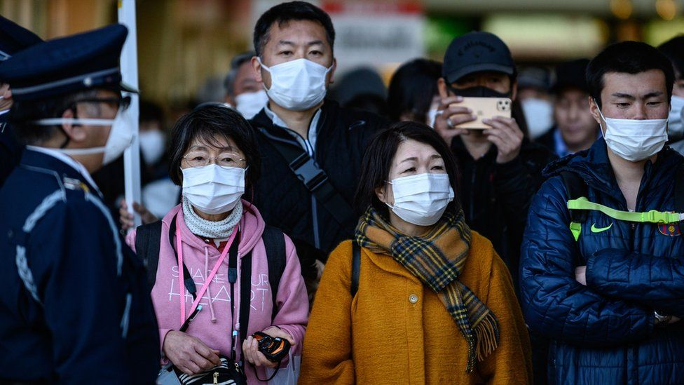
Input for detection from image

Slide 21
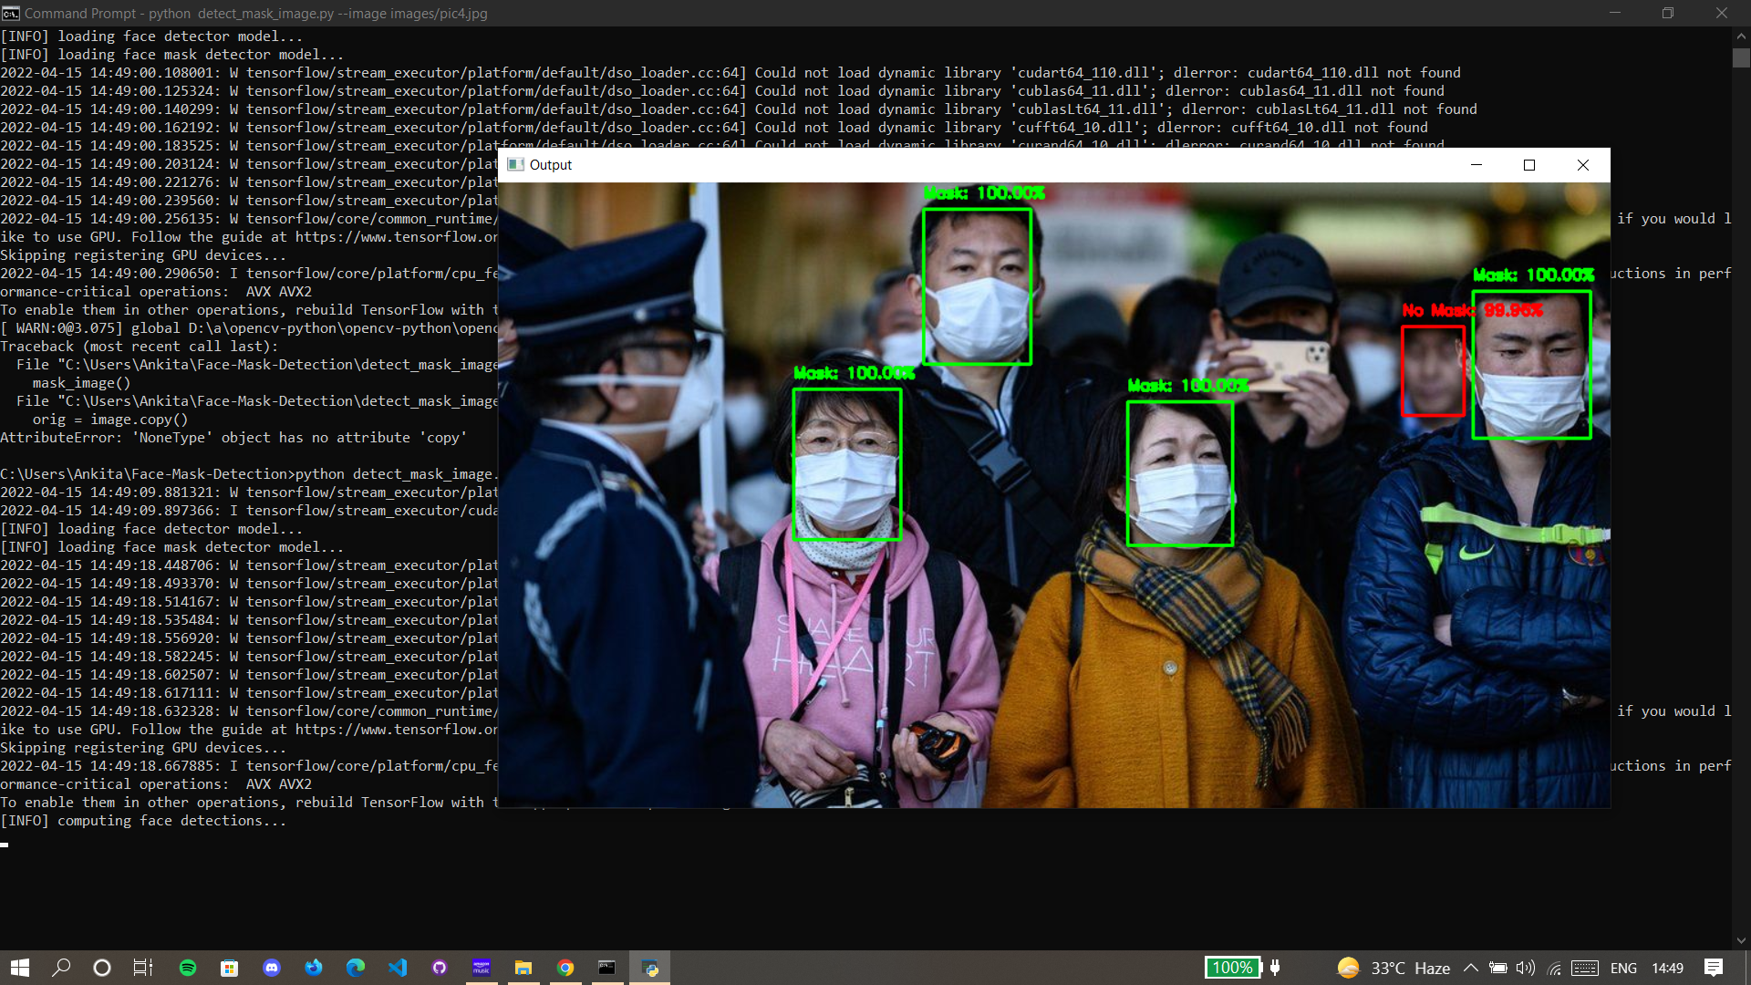
Output for detection from image

Slide 22
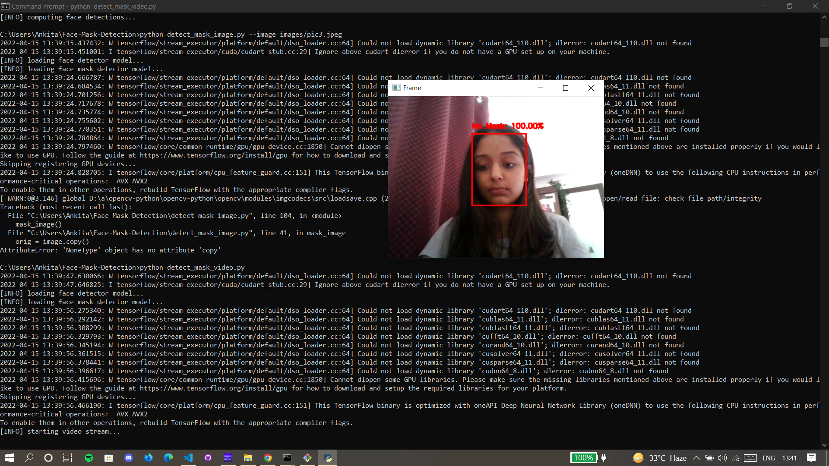
Outputs for detection from webcam

Slide 23
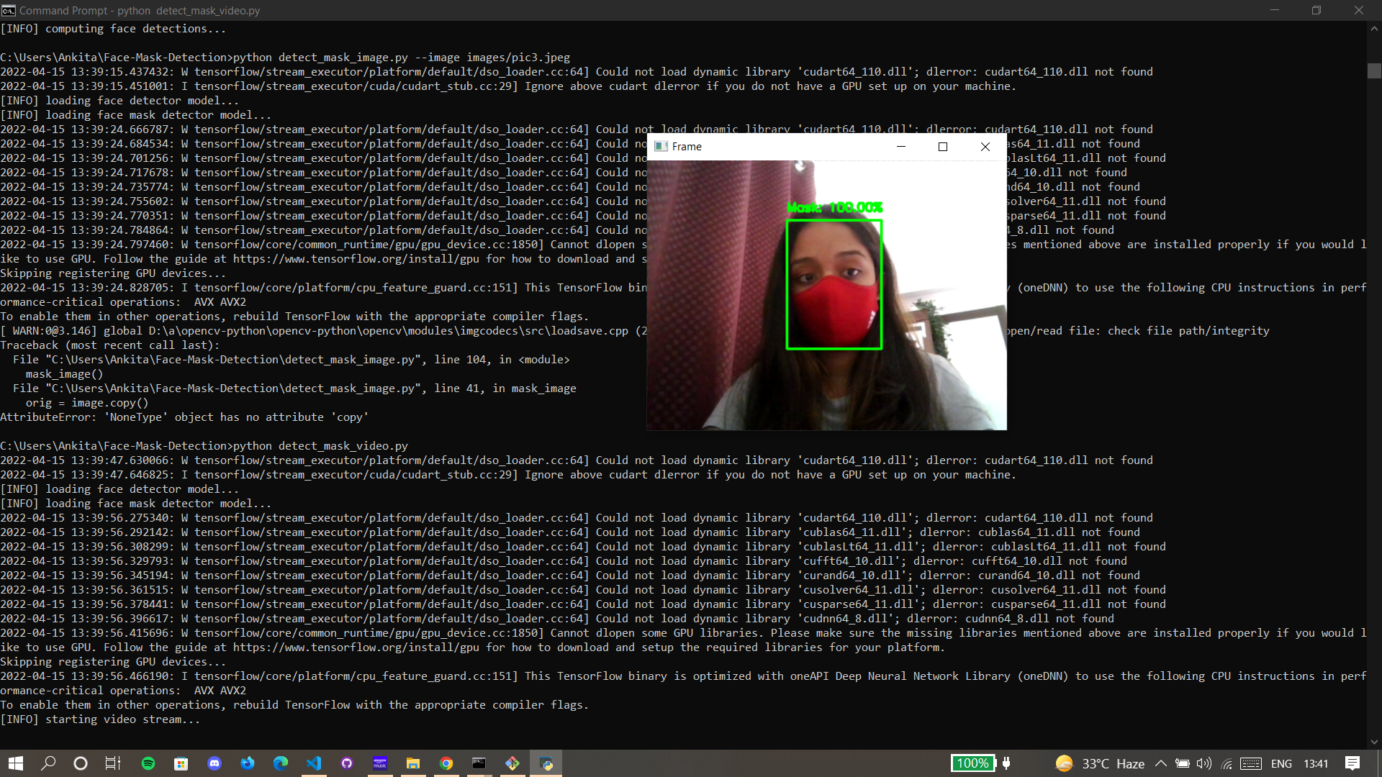
Outputs for detection from webcam

Slide 24
GitHub Link
https://github.com/Vicky-kr-thakur/Face-Mask-Detection

Slide 25
WORKING
Run command cd Face-Mask-Detection in terminal
To detect face masks in an image type the following command in the terminal:
python detect_mask_image.py --image images/pic1.jpeg
To detect face masks in real-time video streams type the following command in the terminal:
python detect_mask_video.py

Slide 26
FUTURE WORKS
Our next phase of implementation will be the development of the Face Mask Detector webapp using Tensorflow & Streamlit. This would make it easier for multiple users to access this project and use this detection system from their Laptops or PCs.

Slide 27
REFERENCES
[https://github.com/chandrikadeb7/Face-Mask-Detection)
https://www.pyimagesearch.com/
https://www.tensorflow.org/tutorials/images/transfer_learning
https://ieeexplore.ieee.org/document/9342585

